Slide 1


IOT-BASED SMART LUGGAGE SYSTEM

Slide 2

Presentation by
Raghavi Epuri
B.Tech in Engineering Science
Indian Institute of Technology Jodhpur

Slide 3
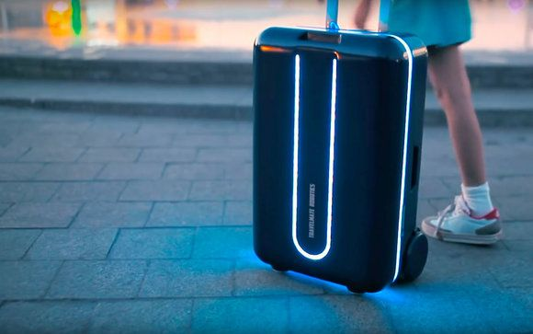
INTRODUCTION AND OVERVIEW
In the modern era, technology has revolutionized the way we interact with our everyday objects. One such innovative application is the integration of Internet of Things (IoT) technology with everyday items to enhance their functionality and usability. The IoT-based Smart Bag using Arduino is a cutting-edge project that aims to transform the conventional bag into an intelligent and interactive companion.

Slide 4
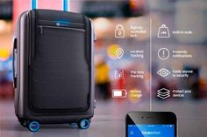
1.Automation and Motorized Movement
Self-Driving: The bag follows the user autonomously using motorized wheels and sensors.
Remote Control: Control the bag via a smartphone app for remote navigation.
2. Obstacle Detection using Bluetooth
Sensors: Detects obstacles using ultrasonic or infrared sensors.
Bluetooth Connectivity: Communicates with a smartphone to navigate and avoid collisions.
3. Weight Detection
Integrated Scales: Built-in scales to measure and display the bag’s weight.
Overweight Alerts: Sends notifications if the weight exceeds preset limits.
KEY FEATURES

Slide 5
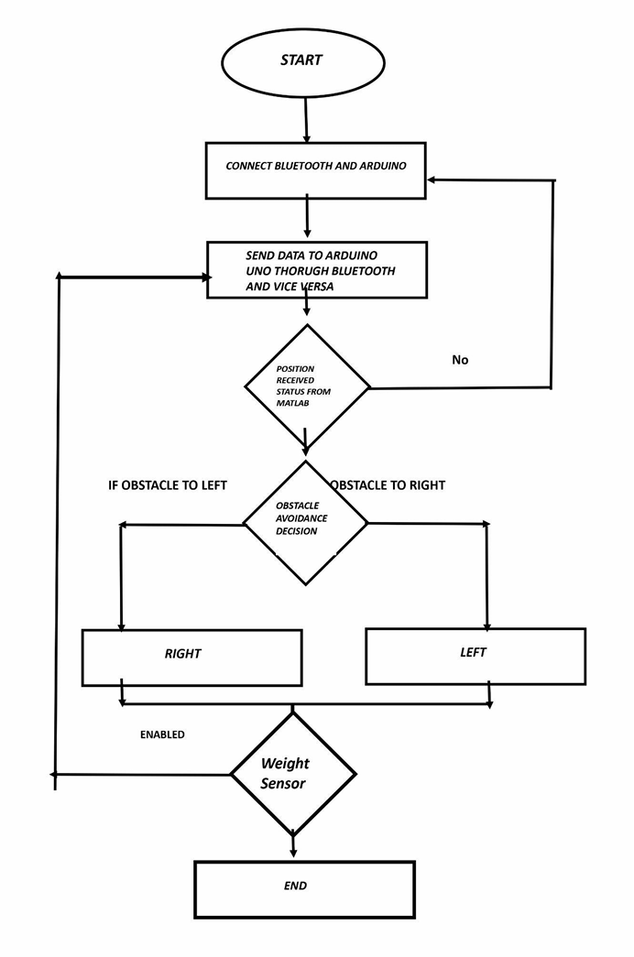
THE FLOW SYSTEM
FLOW CHART

Slide 6
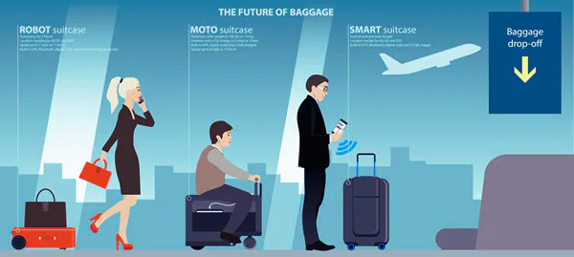
HARDWARE REQUIREMENTS
Arduino Board
Motor drivers
DC Motors
Motor wheels
Bluetooth Module
Weight Sensor
Ultrasonic sensor
Battery Power Supply

Slide 7

SOFTWARE REQUIREMENTS
Matlab for live data trasmision
Arduino IDE
Libraries used
1. Software Serial
2. Tiny GPS PLUS
3. HX711
4. Wire, Arduino

Slide 8
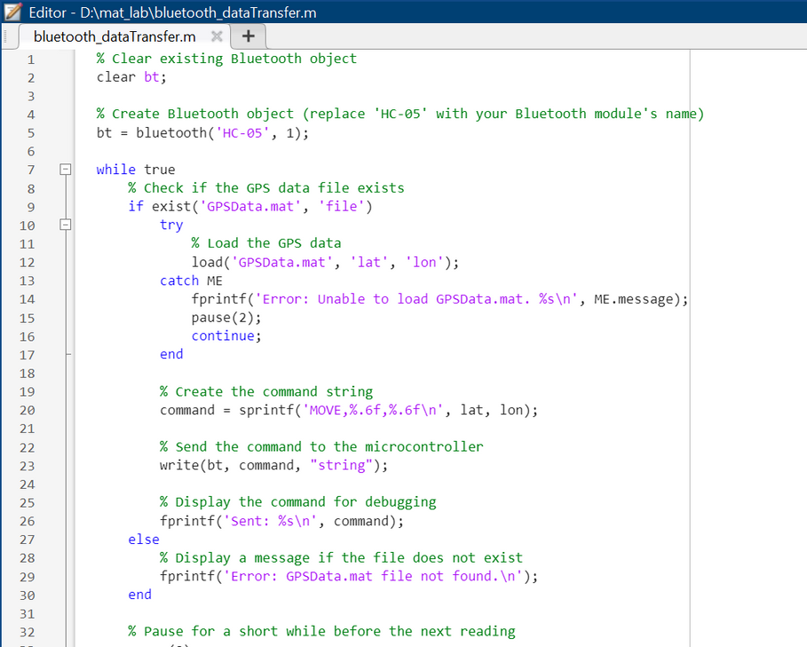
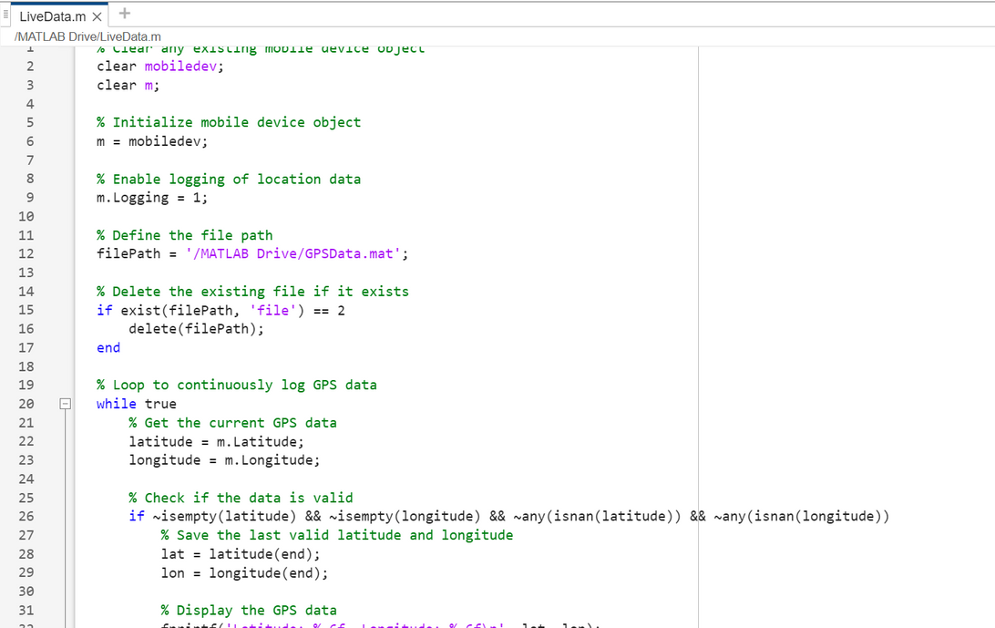
Live Data Transsmission Via MATLAB
GPS Coordinates from MATAB Mobile are transmitted to MATLAB on the laptop and then are trasmitted to Arduino via blutooth Module.

Slide 9
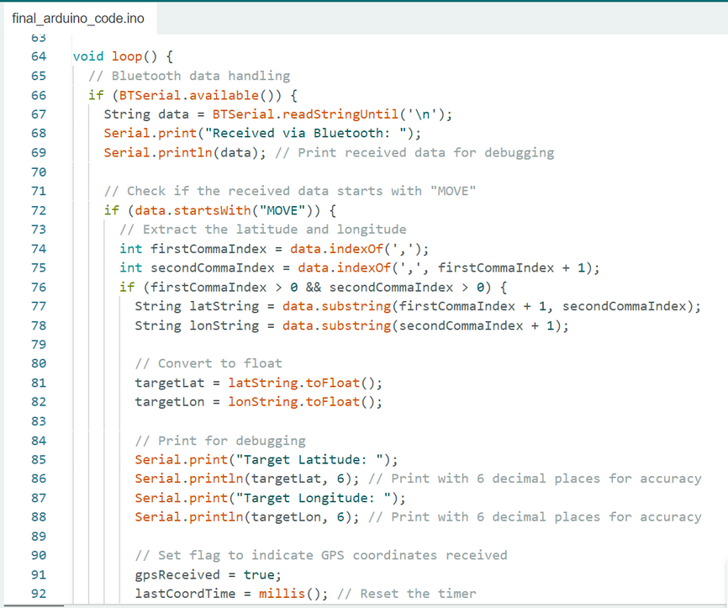
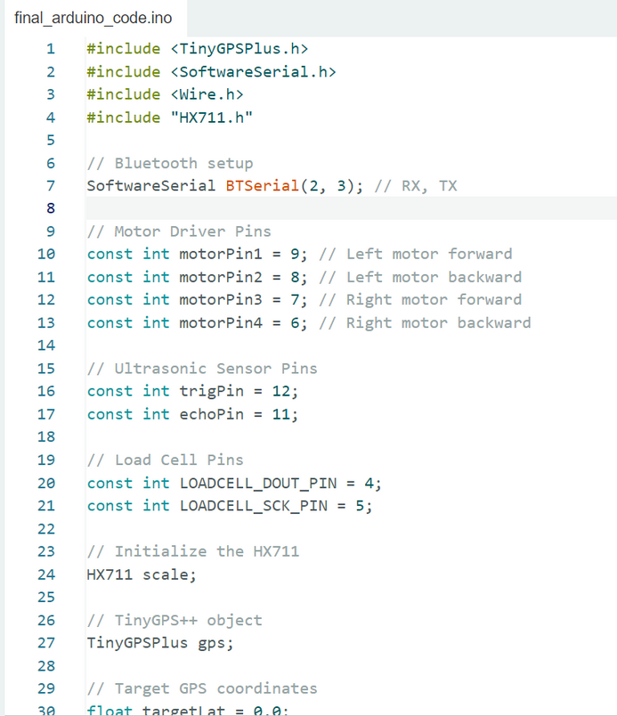
Live Data Reception Via Bluetooth Module On to the Arduino Board
The Tiny GPS PLUS library in the Arduino IDE is used to calclate the distance and the direction towards the target coordinated recieved by Arduino.

Slide 10
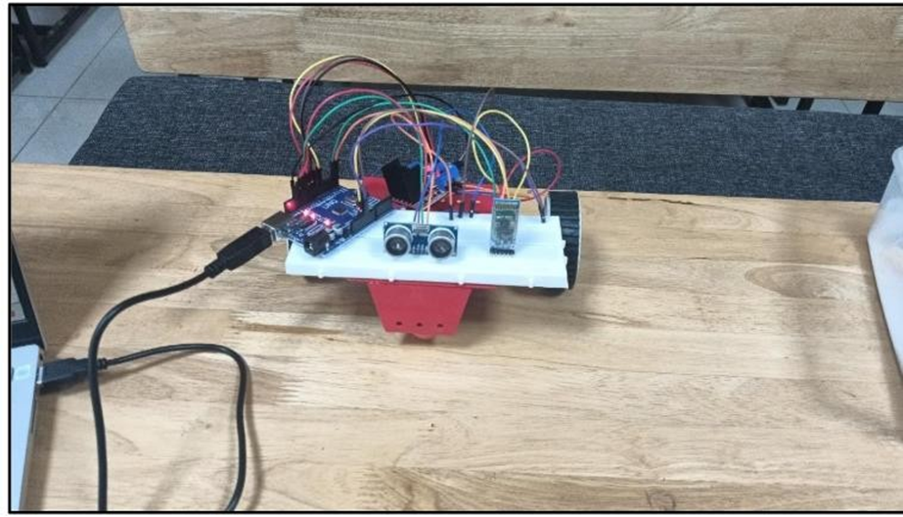
Prototype

Slide 11
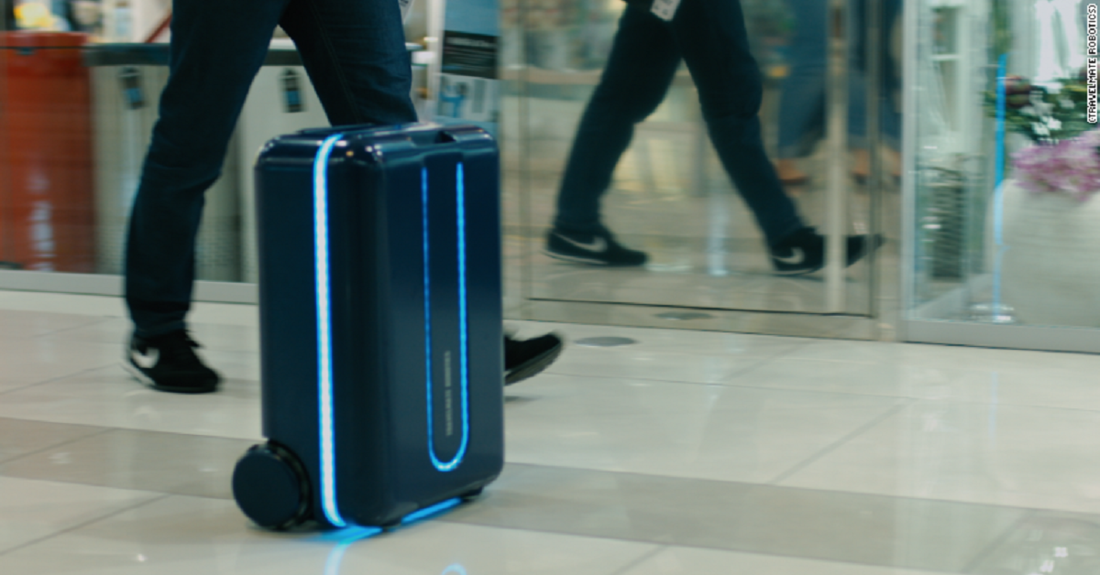
ADVANTAGES
1. Convenience
2. Enhanced Safety and Security
3. Time and Effort Saving
4. Travel Efficiency
5. Connectivity and Accessibility
6. Customization and Flexibility
7. Comfort and Ease
8. Enhanced Travel Experience

Slide 12
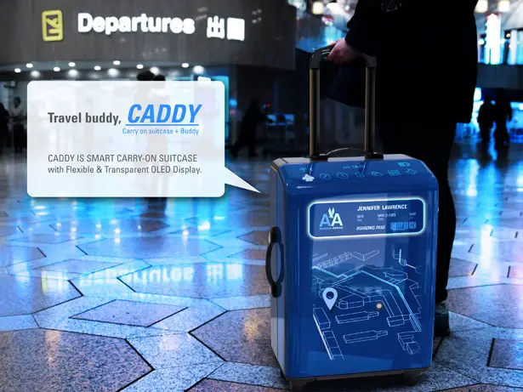
APPLICATIONS
Travel and Commuting:
Travelers can benefit from features like real-time tracking and security alerts to keep their belongings safe.
School and Office:
Students and professionals can use the bag for carrying laptops and other valuables, with added security and monitoring features.

Slide 13
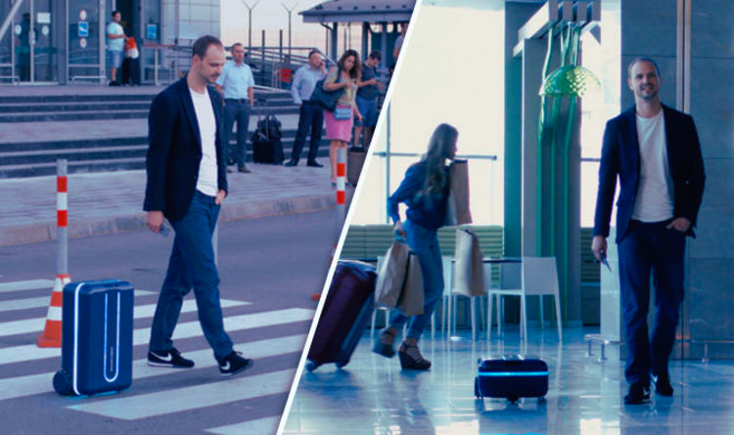
CONCLUSION AND SCOPE
As a result of this project, an innovative carry bag was developed which makes life easier and smoother. The main aim of the project is to facilitate the transport of heavy bags. So through this project, the problem of dragging luggage was tackled and additionally, some security features were provided. This innovation is low-cost and user-friendly. The location of the system can be obtained by the user on their smartphone and they can also stop and start the bag.

Slide 14
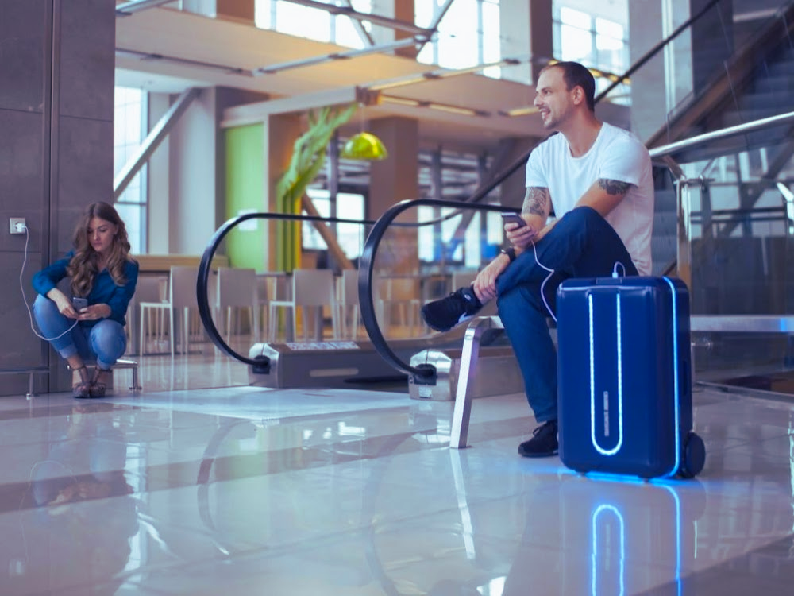
In conclusion, smart travel bags equipped with automation, obstacle detection using Bluetooth, and weight detection represent a significant leap forward in travel technology. These innovations enhance convenience, safety, and efficiency, making travel more seamless and stress-free. By integrating advanced features like self-driving capabilities, real-time obstacle avoidance, and precise weight management, smart travel bags cater to the needs of the modern traveler, offering a smarter, more connected travel experience.

Slide 15
REFERENCES
Prathwik R Amin, Krishna Karanth S, Sharanya M S, Akshatha K, Manjunatha Badiger, 2020, Smart Travel Bag, INTERNATIONAL JOURNAL OF ENGINEERING RESEARCH & TECHNOLOGY (IJERT) IETE – 2020 (Volume 8 – Issue 11)
K. S. Nair, “Smart Luggage Tracker,” International Journal of Research in Engineering, Science and Management, vol. 2, no. 6, p. 3, June 2019
M. J. Sudha Senthilkumar, “LUGGAGE TRACKING SYSTEM USING IOT,” International Journal of Pure and Applied Mathematics, vol. 117, no. Special, p. 9, 2017.
M. Hart, “Arduiniana,” Arduiniana, [Online]. Available: http://arduiniana.org/libraries/tinygpsplus/. [Accessed 2022].
“Arduino Uno,” Wikipedia, [Online]. Available: https://en.m.wikipedia.org/wiki/Arduino_Uno. [Accessed 2022].
“L298N Motor Driver Module,” Components 101, [Online]. Available: https://components101.com/modules/l293n-motor-driver-module. [Accessed 2022].
Arduino, “SoftwareSerial Library,” Arduino.cc, 15 11 2022. [Online]. Available: https://docs.arduino.cc/learn/built-in-libraries/software-serial. [Accessed 2022].
K. H. K. J. D. J. K. E. Maniyar Rut Vipulbhai, “Smart Luggage Carrier,” International Journal Of Creative Research Thoughts (IJCRT), vol. 8, no. 5, p. 4, 2020.
S.Karthick, “SMART LUGGAGE TRACKING AND ALERT SYSTEM USING ARDUINO,” International Research Journal of Modernization in Engineering Technology and Science, vol. 2, no. 5, p. 6, 2020.

Slide 16
THANK YOU

